Slide 1
DS677 Final Project BayesBank – Bayesian Neural Network (BNN)
By Bianco Blanco Group 19
bmb45@njit.edu
5/11/2025

Slide 2
Why BNN?
Traditional models give single point predictions but do not express confidence.
It is more worth a marketer's time to pursue high confidence prospects compared to uncertain ones.
BNNs allow static predictions to become lively dynamic probabilistic outcomes, that in turn makes the inherent risk more visible.

Slide 3
Dataset and Data-Prep
Dataset: UCI Bank Marketing (Portuguese bank campaigns)
Target: Did the client want to subscribe to a term deposit?
~45k records, 42 engineered features
Data Prep:
For missing integer values input the mean
One-hot encode categorical variables, ensuring to factor for collinearity
Standardize numbers due to the probabilistic nature being more receptive to normalized values
No removal of outliers allow BNN to deal with outliers.

Slide 4
What is a BNN?
Definition for Neural Network (from IBM): A neural network is a machine learning program, or model, that makes decisions in a manner similar to the human brain, by using processes that mimic the way biological neurons work together to identify phenomena, weigh options and arrive at conclusions.
How are BNNs different?
Weights are distributions
Outputs are distribution over predictions

Slide 5
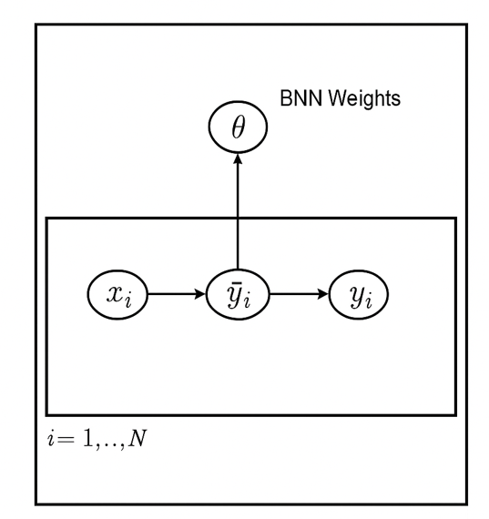

Model Architecture
Input = 42 input features ->
BayesianLinear(42, 50) ->
ReLU ->
BayesianLinear (50,1) ->
Sigmoid
Uses Bayes-by-Backprop
$𝒩\sim (μ,σ^{2})$
$ε \sim 𝒩\left(0,1\right)$
$θ= μ+ σ∙ε$

Slide 6

Loss Function (-ELBO)
$ℒ=KL(q(θ)||p\left(θ\right)+𝔼_{q\left(θ\right)}[−logp\left(y | x, θ\right)]$
KL: Regularizes the weights toward the prior
NLL: Encourages good predictions
Prior: Gaussian with σ = 1

Slide 7
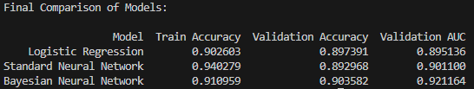
Results
Performance –
Selective Prediction
Using Monte Carlo dropout, we can reject top 10% most uncertain which brought accuracy from .905 to .939
Error Analysis
FPR – 3.4% and FNR – 6.4%
False positive being older people with low-balance retirees and false negatives are young, high-balance professionals
Notes:
So, how well does BayesBank perform?
Compared to logistic regression and a standard neural network:
It achieves higher AUC (0.923) and better validation accuracy (90.5%)
It’s also better calibrated—meaning its predicted probabilities match real-world frequencies
And here’s the cool part: BayesBank supports selective prediction.
By rejecting the 10% most uncertain predictions (based on variance from 100 forward passes), accuracy jumps from 90.5% to 93.8%. That’s huge if you're only acting on high-confidence predictions.
You can visualize this with a calibration curve, which shows BayesBank’s outputs are well-aligned with actual outcomes.

Slide 8
Future Work
Integrate into cloud ML pipelines for real-time campaign scoring
Explore mixture of Gaussians as priors for complex posterior shapes

Slide 9
Conclusion
BNNs are quintessential to cutting deep into what drives campaign success.
With the modernization of GPUs and the ramping supply of competitive consumer hardware implementing BNNs might turn a realistic opportunity into a materialized action.

Slide 10
Links
Github
YouTube
Report
Dataset

